Slide 1

Internet Technologies
ITI & XI-IT
Lesson 9: Frameworks
Bootstrap, jQuery, Leaflet & Coogle Charts
Henrik Lange

Slide 2
Plan
Week 1: HTML & CSS
Week 2: JavaScript
Week 3: HTTP, PHP & AJAX (march 1st)
Week 4: MariaDB / MySQL (march 8th)
Week 5: Recap, Internet History, Project help (march 15th)
Week 6: Project Hand-In (march 22nd)
Week 6: OOP PHP, MVC, Routers, Reflection
Week 6: Midway Evaluation
Week 7: Project Presentation (march 29th)
Week 7: Assignment 2 specification
Week 8: API’s, REST & SOAP
Week 9: Libraries & Frameworks
(Bootstrap, jQuery, Leaflet, Google Charts)
Week 10: Javascript, Search Engine Optimization
Week 11: ASP .net LINQ scaffolding, A2 hand-in
Week 12: Presentations, Feedback, Recap, Exam Questions

Slide 3
Agenda
Bootstrap
jQuery
Google Charts
Leaflet

Slide 4


Slide 5
Bootstrap getting started
Build responsive, mobile-first projects on the web with the world’s most popular front-end component library.
Bootstrap is an open source toolkit for developing with HTML, CSS, and JS. Quickly prototype your ideas or build your entire app with our Sass variables and mixins, responsive grid system, extensive prebuilt components, and powerful plugins built on jQuery.

Slide 6
Bootstrap getting started
Responsive
Mobile-first
Front-end
HTML and CSS
jQuery.

Slide 7
Bootstrap getting started
In the HTML head:
CSS & JavaScript
Or download it and include it like any other css & javascript
https://getbootstrap.com/docs/4.3/getting-started/introduction/
<link rel="stylesheet" href="https://maxcdn.bootstrapcdn.com/bootstrap/3.3.7/css/bootstrap.min.css" integrity="sha384-BVYiiSIFeK1dGmJRAkycuHAHRg32OmUcww7on3RYdg4Va+PmSTsz/K68vbdEjh4u" crossorigin="anonymous">
<script src="https://maxcdn.bootstrapcdn.com/bootstrap/3.3.7/js/bootstrap.min.js" integrity="sha384-Tc5IQib027qvyjSMfHjOMaLkfuWVxZxUPnCJA7l2mCWNIpG9mGCD8wGNIcPD7Txa" crossorigin="anonymous"></script>

Slide 8
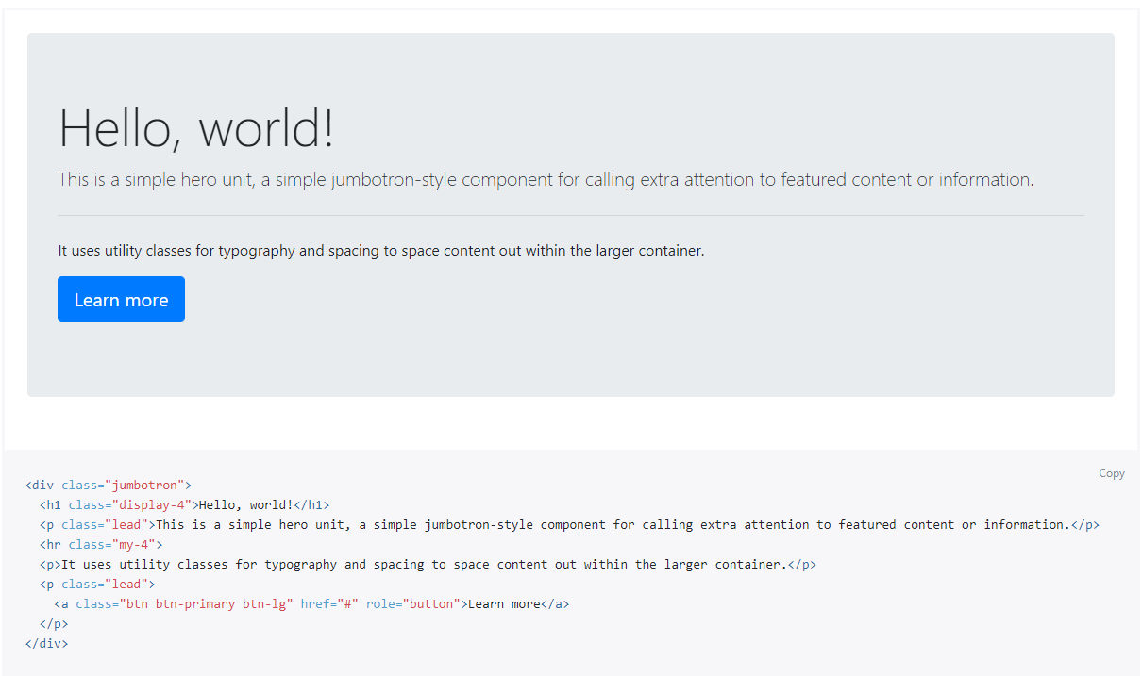
Jumbotron

Slide 9
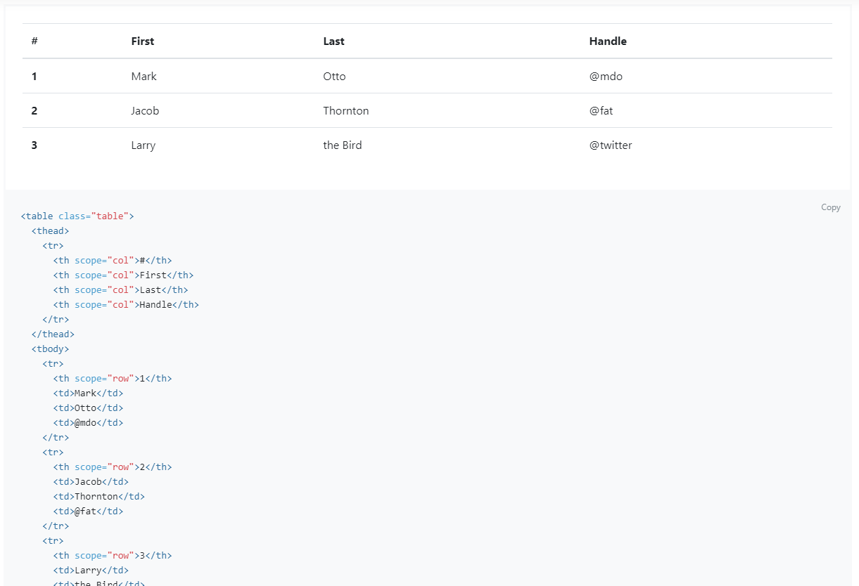
Tables

Slide 10
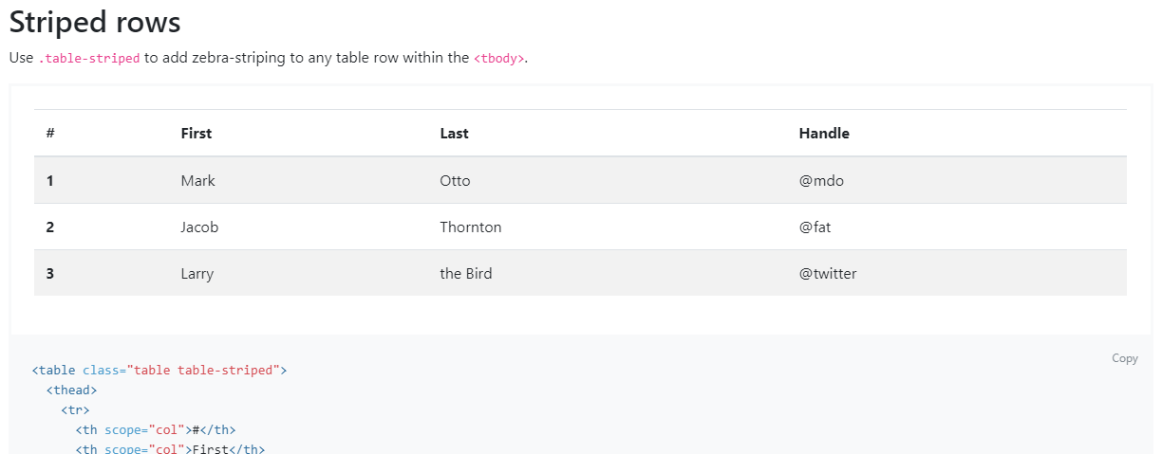
Tables

Slide 11
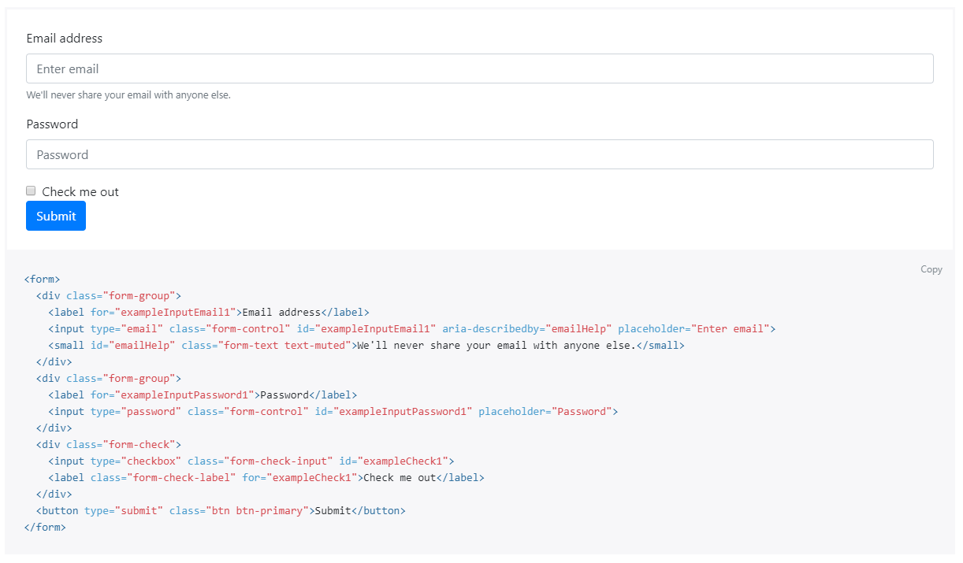
Forms

Slide 12
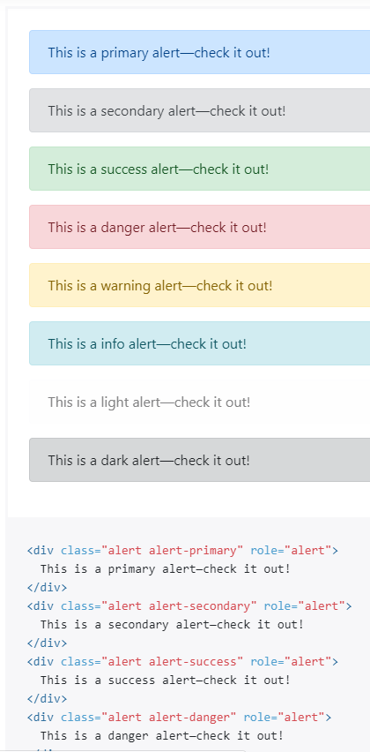
Alerts

Slide 13
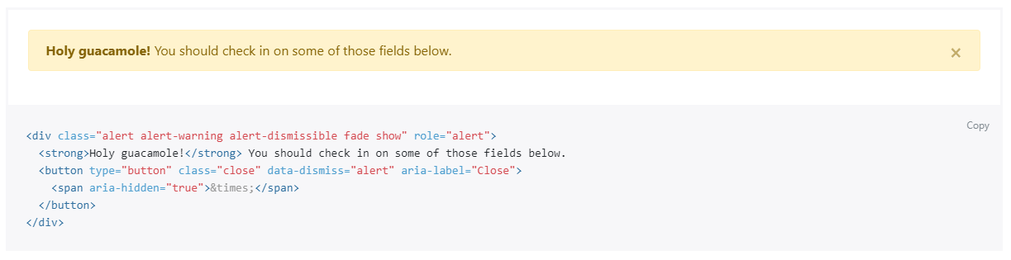
Alerts

Slide 14
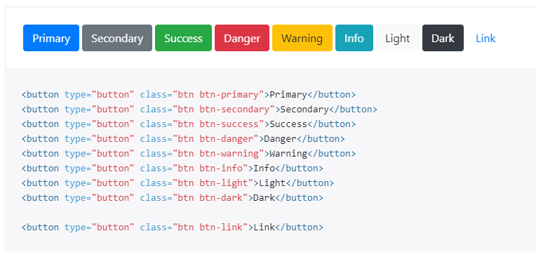
Buttons

Slide 15
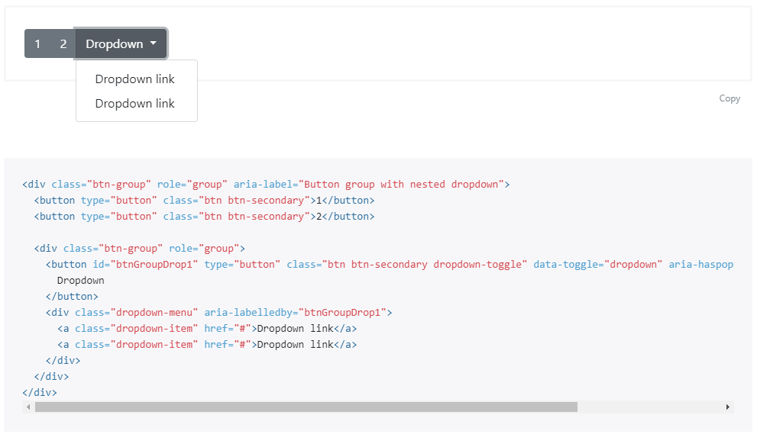
Button-groups

Slide 16
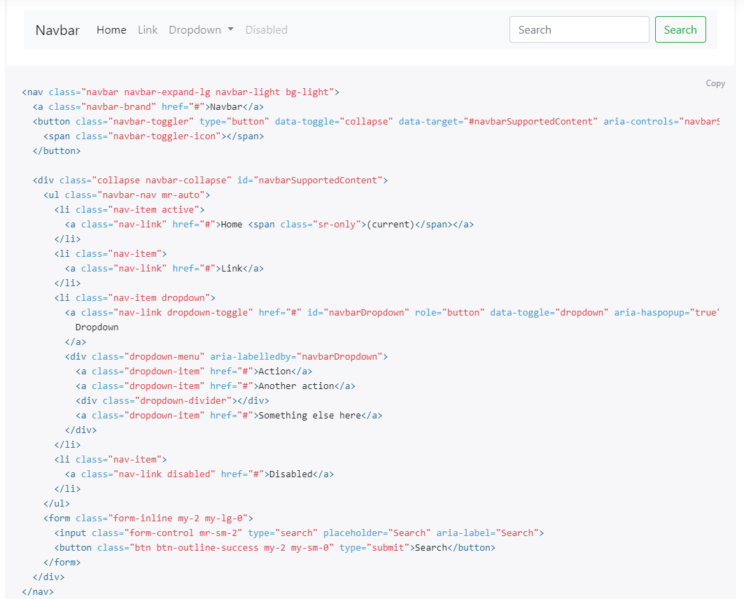
Navbar responsive

Slide 17
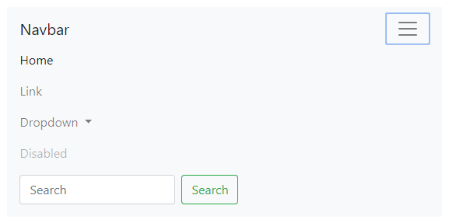
Navbar responsive

Slide 18
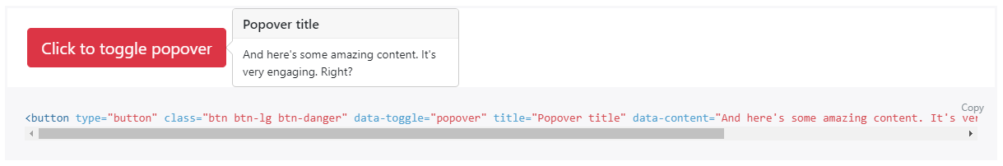
Popover

Slide 19
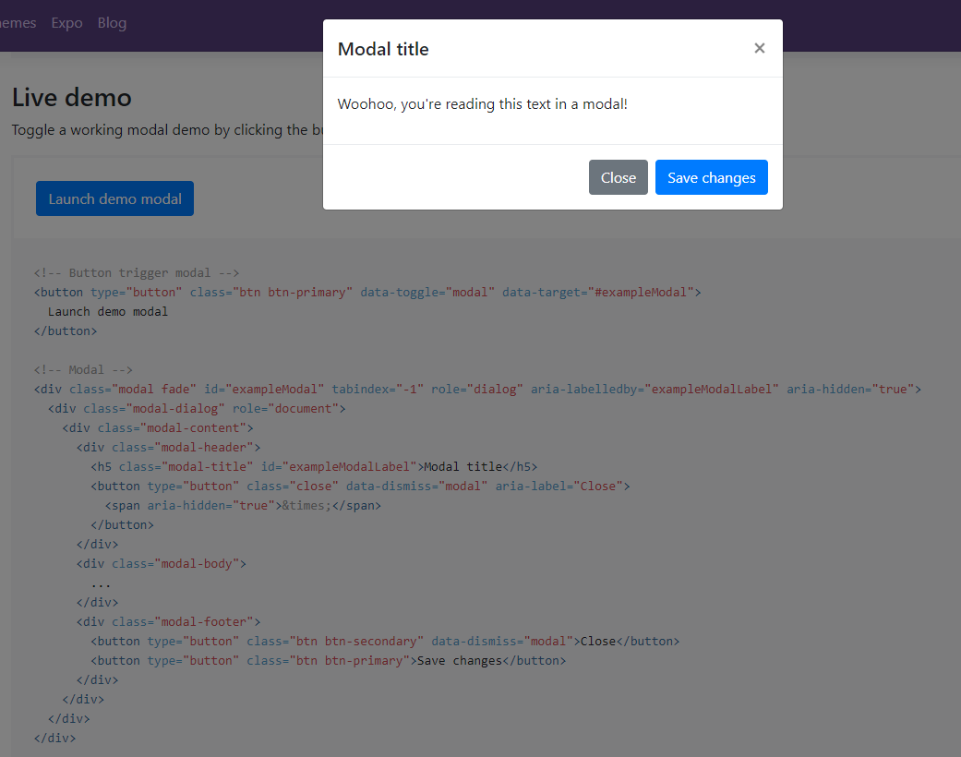
Modal

Slide 20
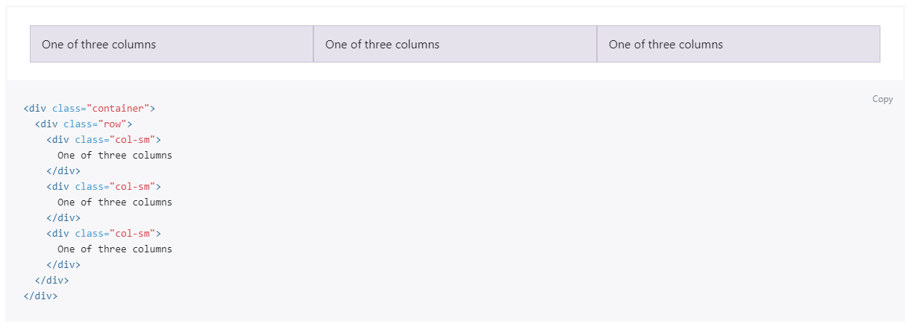
Grid System

Slide 21
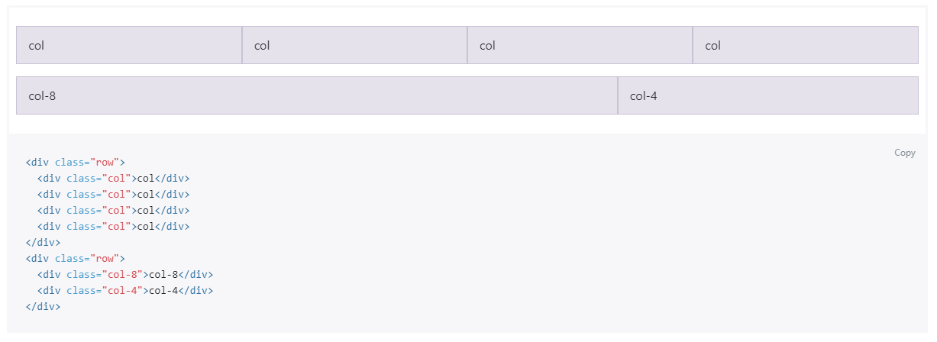
Grid System
More: https://uxplanet.org/how-the-bootstrap-4-grid-works-a1b04703a3b7

Slide 22
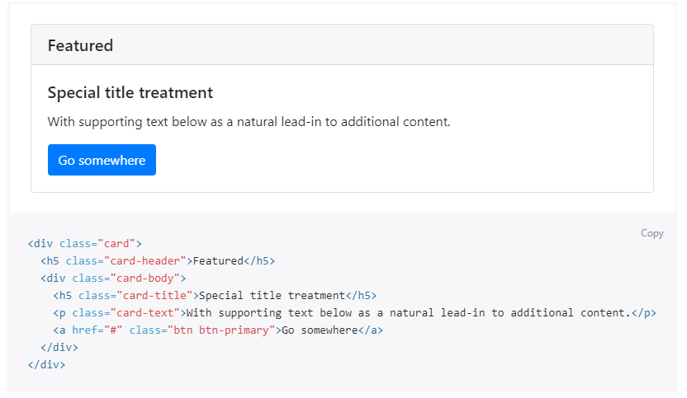
Card / Panel

Slide 23
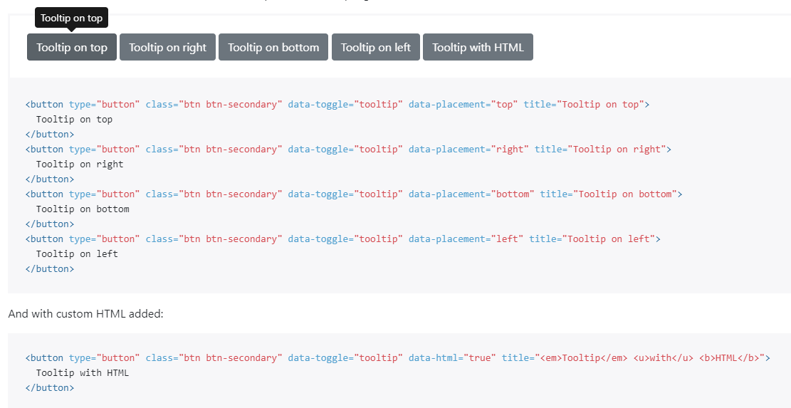
Tooltip

Slide 24


Slide 25
jQuery.com
“jQuery is a fast, small, and feature-rich JavaScript library. It makes things like HTML document traversal and manipulation, event handling, animation, and Ajax much simpler with an easy-to-use API that works across a multitude of browsers. With a combination of versatility and extensibility, jQuery has changed the way that millions of people write JavaScript.”

Slide 26
Why jQuery?
Used in tons of production systems
Most?
Automatically included and used in .net templates
Some people can’t tell the difference between jQuery and JS
You must be able to!
Just look up any JS problem on stackoverflow, and the replies will be for jQuery

Slide 27
jQuery History
Created in 2006
To make it easier to write JavaScript
To make cross-browser compatibility simpler
“Write less, do more”
With EcmaScript 6 (EC6), JavaScript is as easy to write as jQuery in almost all cases
But you WILL run into it
Again and again
And possibly have to work with it.

Slide 28
jQuery Topics
jQuery Basic
jQuery UI
jQuery Ajax

Slide 29
$
Whenever you see a $ in JavaScript, you should think jQuery
jQuery is JUST JavaScript!
$ is a legal character in JavaScript
jQuery uses $ heavily

Slide 30
Getting Started
In your HTML head:
Or download it and include it like any other JavaScript
If you use Bootstrap, you most already have it on your site!
<script src="https://ajax.googleapis.com/ajax/libs/jquery/3.3.1/jquery.min.js"></script>

Slide 31
Getting Started
In your HTML head:
Or download it and include it like any other JavaScript
If you use Bootstrap, you most already have it on your site!
<script src="https://ajax.googleapis.com/ajax/libs/jquery/3.3.1/jquery.min.js"></script>

Slide 32
On Page Load
Do something when page loads:
jQuery
JavaScript
$(‘document’).ready(function() {
//your code…
});
document.onload = function () {
//your code…
}

Slide 33
Find DOM element
Find DOM element
Change inner HTML
Change style
jQuery
JavaScript
$(‘div.menu .selected’);
document.querySelector(‘div.menu .selected’);
$(‘div.menu .selected’)
.html(‘new content’);
document
.querySelector(‘div.menu .selected’)
.innerHTML = ‘new content’;
$(‘div.menu .selected’)
.css(‘color’, ‘red’);
document
.querySelector(‘div.menu .selected’)
.style.Color = ‘red’;

Slide 34
Experiment
We use q instead of $ to avoid confusion
jQuery selectors can go beyond the JS querySelector
p:contains(‘specific words’)
jQuery
JavaScript
function q (search) {
return document.querySelector(search);
}
$(‘div.menu .selected’);
q(‘div.menu .selected’);

Slide 35
Find DOM element
Find DOM element
Change inner HTML
Change style
Change attribute
jQuery
JavaScript
$(‘div.menu .selected’);
q(‘div.menu .selected’);
$(‘div.menu .selected’)
.html(‘new content’);
q(‘div.menu .selected’)
.innerHTML = ‘new content’;
$(‘div.menu .selected’)
.css(‘color’, ‘red’);
q(‘div.menu .selected’)
.style.Color = ‘red’;
$(‘img’).attr(‘src’, ‘newImage.png’);
q(‘img’).src = ‘red’;

Slide 36
Add / Remove Class
Add Class
Remove class
Toggle class
jQuery
JavaScript
$(”#whatever”)
.addClass(”anotherClass”);
q(”#whatever”)
.classList
.add(”anotherClass”);
$(”#whatever”)
.removeClass(”anotherClass”);
q(”#whatever”)
.classList
.remove(”anotherClass”);
$(”#whatever”)
.toggle(”anotherClass”);
q(”#whatever”)
.classList
.toggle(”anotherClass”);

Slide 37
Add Events
jQuery
JavaScript
$(”button.myButton”)
.click(function() {
//event
});
q(”button.myButton”)
.addEventListener(”click”, function() {
//event
});
$(”button.myButton”)
.hover(function() {
//event
});
q(”button.myButton”)
.addEventListener(”hover”, function() {
//event
});
$(”button.myButton”)
.dblclick(function() {
//event
});
q(”button.myButton”)
.addEventListener(”dblclick”, function() {
//event
});

Slide 38
Find Mouse Position
jQuery
JavaScript
$(”button.myButton”)
.click(function(e) {
$(‘posX’).val(e.pageX);
$(‘posX’).val(e.pageY);
});
q(”button.myButton”)
.addEventListener(”click”, function(e) {
var posX = clientX;
var posY = clientY;
});
jQuery
JavaScript
$(”button.myButton”)
.move(function(e) {
$(‘posX’).val(e.screenX);
$(‘posX’).val(e.screenY);
});
q(”button.myButton”)
.addEventListener(”mousemove”, function(e) {
var posX = clientX;
var posY = clientY;
});

Slide 39
Tables
jQuery
CSS
$(”#myTable tr:first”)
.css(”background-color”, ”blue”);
$(”#myTable tr:even”)
.css(”background-color”, ”white”);
$(”#myTable tr:odd”)
.css(”background-color”, ”grey”);
#myTable tr:first-child {
background-color: white;
}
#myTable tr:nth-child(even) {
background-color: white;
}
#myTable tr:nth-child(odd) {
background-color: grey;
}
First | Row | Blue
Even | Row | White
Odd | Row | Grey
Even | Row | White
Odd | Row | Grey

Slide 40
AJAX
<div>Ajax: <span id=”ajaxContent"></span></div>
jQuery
JavaScript fetch
$.ajax({
type: "GET",
url: "someServerService.php",
success: function(text) {
$('#ajaxContent ').text(text);
},
error: function(XMLHttpRequest, textStatus, errorThrown) {
$('#ajaxContent ').text('Error: ' + errorThrown);
}
});
fetch('someServerService.php’)
.then(function(response) {
return response.text();
})
.then(function(text) {
q('#ajaxContent').innerHTML = text;
})
.catch(function(error) {
q('#ajaxContent').innerHTML = 'Request failed: ' + error;
});
var xmlhttp = new XMLHttpRequest();
xmlhttp.onreadystatechange = function() {
if(this.readyState == 4 && this.status == 200) {
q('#ajaxContent').innerHTML = this.responseText;
} else {
q('#ajaxContent').innerHTML = 'Request failed: ' + this.responseText;
}
}
xmlhttp.open("GET", "someServerService.php", true);
xmlhttp.send();
JavaScript
XMLHttpRequest

Slide 41
jQuery UI
jQueryUI.com
Select Themes
Select Gallery
Download something you like
Click download on the bottom of the next page
Open zip and copy minified .js and .css files
Import them like any other JS and CSS
jQuery must be imported in a supported version

Slide 42
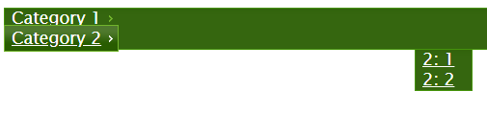
jQuery UI – Menu Widget
<ul id="myMenu">
<li><a href="#">Category 1</a>
<ul>
<li><a href="#">1: 1</a></li>
<li><a href="#">1: 2</a></li>
</ul>
</li>
<li><a href="#">Category 2</a>
<ul>
<li><a href="#">2: 1</a></li>
<li><a href="#">2: 2</a></li>
</ul>
</li>
</ul>
$("#myMenu").menu({
position: {
my: "center top",
at: "center bottom"
}
});
https://api.jqueryui.com/menu/

Slide 43
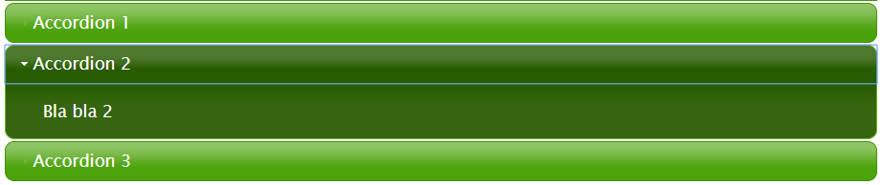
jQuery UI – Accordion
<div id="accordion">
<h4>Accordion 1</h4>
<div>Bla bla 1</div>
<h4>Accordion 2</h4>
<div>Bla bla 2</div>
<h4>Accordion 3</h4>
<div>Bla bla 3</div>
</div>
$("#accordion").accordion({
animate: 500,
active: 1,
collapsible: true,
event: "click",
heightStyle: "content"
});
https://jqueryui.com/accordion/

Slide 44
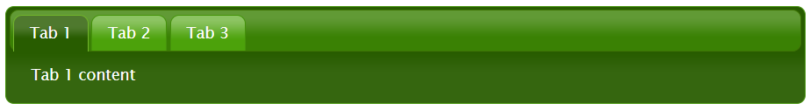
jQuery UI – Tabs
<div id="tabs">
<ul>
<li><a href="#tab1">Tab 1</a></li>
<li><a href="#tab2">Tab 2</a></li>
<li><a href="#tab3">Tab 3</a></li>
</ul>
<div id="tab1">Tab 1 content</div>
<div id="tab2">Tab 2 content</div>
<div id="tab3">Tab 3 content</div>
</div>
$("#tabs").tabs({
event: "click",
show: "fadeIn",
hide: "fadeOut",
active: 3,
collapsible: true,
heightStyle: "auto"
});
https://jqueryui.com/accordion/

Slide 45
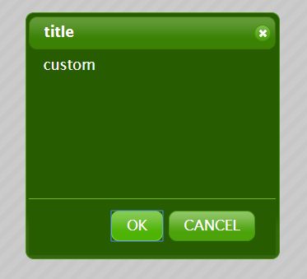
jQuery UI – Dialog (Modal)
$("#customDialog").dialog({
draggable: true,
resizeable: false,
title: "title",
height: 300,
width: 300,
modal: true,
position: {
my: 'center top',
at: 'center bottom',
of: "#openDialog"
},
show: 1000,
hide: 1000,
autoOpen: false,
buttons: {
"OK": function() {
$("#openDialog").html("You clicked OK");
$(this).dialog("close");
},
"CANCEL": function() {
$("#openDialog").html("You clicked cancel");
$(this).dialog("close");
}
}
});
$("#openDialog").click(function() {
$("#customDialog").dialog("open");
});
<div id="openDialog">open</div>
<div id="customDialog"">custom</div>
https://jqueryui.com/dialog/

Slide 46
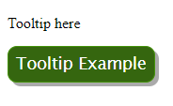
jQuery UI – Tooltip
<div title=”Tooltip Example">Tooltip here</div>
$(”[title]").tooltip();
https://jqueryui.com/tooltip/

Slide 47

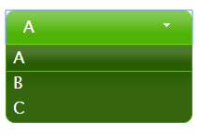
jQuery UI – Select Menu
<select id="select-menu">
<option>A</option>
<option>B</option>
<option>C</option>
</select>
$("#select-menu").selectmenu({
width: 200
});
https://jqueryui.com/selectmenu/

Slide 48
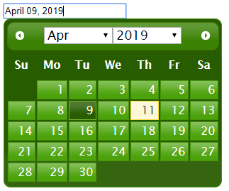
jQuery UI – Date picker
<input type="text" id="birthday" />
$("#birthday").datepicker({
changeMonth: true,
changeYear: true,
dateFormat: "MM dd, yy",
numberOfMonths: 1,
maxDate: 365,
minDate: -3650
});
https://jqueryui.com/datepicker/

Slide 49
jQuery UI – Progress Bar
<div id="progressbar"></div>
$( "#progressbar" ).progressbar({
value: 37
});
https://jqueryui.com/progressbar/

Slide 50
jQuery UI – Drag & Drop
$("#a").draggable();
$("#b").draggable();
$("#c").draggable();
$("#cart").droppable({
activeClass: "highlight",
hoverClass: "hoverDroppable",
drop: function(event, ui) {
ui.helper.hide("fade");
var itemAlt = $(ui.draggable).attr("alt");
alert("Item added: " + itemAlt);
},
accept: ".pink",
disable: false,
activate: function(event, ui){
$("#message").html();
$(this).html("<span id='cartMsg'>Drop It Here!</span>");
},
deactivate: function(event, ui){
$("#message").html();
$(this).html("<span id='cartMsg'>Try again!</span>");
},
over: function(event, ui){
$("#message").html();
$(this).html("<span id='cartMsg'>Let it go!</span>");
},
out: function(event, ui){
$("#message").html();
$(this).html("<span id='cartMsg'>Come back!</span>");
}
});
<div id="message"></div>
<div class="blue" id="cart"></div>
<div class="pink" id="a" alt="a"></div>
<div class="pink" id="b" alt="b"></div>
<div class="pink" id="c" alt="c"></div>
.blue, .pink{
width: 100px;
height: 100px;
margin: 10px;
}
.blue { background-color: lightblue; }
.pink { background-color: pink; }
.hightlight { border: 4px solid grey; }
https://jqueryui.com/draggable/
https://jqueryui.com/droppable/

Slide 51
jQuery UI – Drag & Drop
$("#a").draggable();
$("#b").draggable();
$("#c").draggable();
$("#cart").droppable({
activeClass: "highlight",
hoverClass: "hoverDroppable",
drop: function(event, ui) {
ui.helper.hide("fade");
var itemAlt = $(ui.draggable).attr("alt");
alert("Item added: " + itemAlt);
},
accept: ".pink",
disable: false,
activate: function(event, ui){
$("#message").html();
$(this).html("<span id='cartMsg'>Drop It Here!</span>");
},
deactivate: function(event, ui){
$("#message").html();
$(this).html("<span id='cartMsg'>Try again!</span>");
},
over: function(event, ui){
$("#message").html();
$(this).html("<span id='cartMsg'>Let it go!</span>");
},
out: function(event, ui){
$("#message").html();
$(this).html("<span id='cartMsg'>Come back!</span>");
}
});
<div id="message"></div>
<div class="blue" id="cart"></div>
<div class="pink" id="a" alt="a"></div>
<div class="pink" id="b" alt="b"></div>
<div class="pink" id="c" alt="c"></div>
.blue, .pink{
width: 100px;
height: 100px;
margin: 10px;
}
.blue { background-color: lightblue; }
.pink { background-color: pink; }
.hightlight { border: 4px solid grey; }
https://jqueryui.com/draggable/
https://jqueryui.com/droppable/

Slide 52


Slide 53
Leaflet
“Leaflet is the leading open-source JavaScript library for mobile-friendly interactive maps”
“Leaflet is designed with simplicity, performance and usability in mind. It works efficiently across all major desktop and mobile platforms, can be extended with lots of plugins, has a beautiful, easy to use and well-documented API and a simple, readable source code that is a joy to contribute to.”
https://leafletjs.com/examples/quick-start/

Slide 54
Leaflet – get started
Import leaflet in HTML head
Remember to set viewport!
Create a <div> for the map
<div> must have a specified width!
<meta name="viewport" content="width=device-width, initial-scale=1.0">
<link rel="stylesheet" href="https://unpkg.com/leaflet@1.0.2/dist/leaflet.css">
<script src="https://unpkg.com/leaflet@1.0.2/dist/leaflet.js"></script>
<div id="map" style="width: 700px; height: 400px;"></div>
https://leafletjs.com/examples/quick-start/

Slide 55
Leaflet – get started
Set centrum coordinates in JavaScript
Set a tile layer
You now have a live map!
Scrolling and zooming is enabled by default
var map = L.map('map').setView([56.255, 10.08], 12);
L.tileLayer('http://{s}.tile.osm.org/{z}/{x}/{y}.png', {
attribution: '&copy; <a href="http://osm.org/copyright">OpenStreetMap</a> contributors'
}).addTo(map);
https://leafletjs.com/examples/quick-start/

Slide 56
Leaflet – get started
Add circles and markers with optional popups
Popups support rich HTML
L.circle([56.2568605075, 10.0888809242], 1200, {color: "red"})
.bindPopup('Popup for <span style="color: #f00;">red</span> circle.')
.addTo(map);
L.circle([56.2569805095, 10.0688809249], 1000).addTo(map);
L.marker([56.2569805095, 10.0788809249]).addTo(map)
.bindPopup('Popup for <span style="color: #00f;">blue</span> marker')
.openPopup();
L.marker([56.2669805095, 10.0788809249]).addTo(map)
.openPopup();

Slide 57
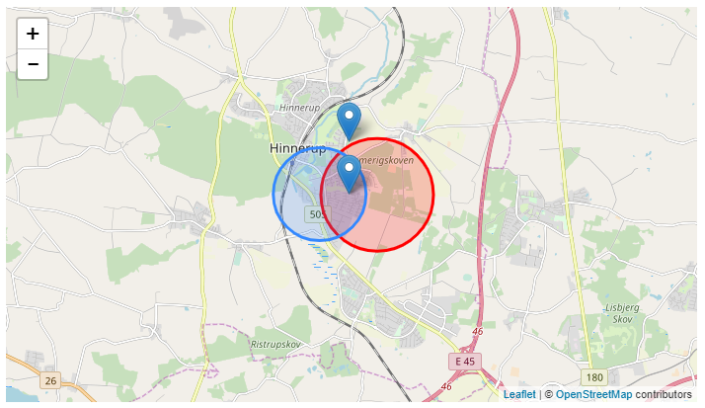
Leaflet – get started

Slide 58
Google Charts

Slide 59
Google Charts
Import in HTML Head
Make placeholder div in HTML body
We can now use the charts to populate the div in various ways
https://developers.google.com/chart/interactive/docs/gallery
<script type="text/javascript" src="https://www.gstatic.com/charts/loader.js"></script>
<div id="chart_div"></div>

Slide 60
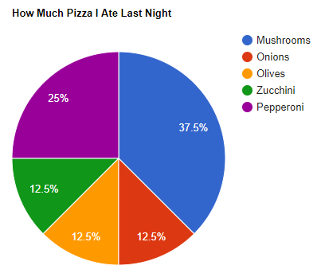
Google Charts
google.charts.load('current', {'packages':['corechart']});
google.charts.setOnLoadCallback(drawChart);
function drawChart() {
var data = new google.visualization.DataTable();
data.addColumn('string', 'Topping');
data.addColumn('number', 'Slices');
data.addRows([
['Mushrooms', 3],
['Onions', 1],
['Olives', 1],
['Zucchini', 1],
['Pepperoni', 2]
]);
var options = {'title':'How Much Pizza I Ate Last Night',
'width':700,
'height':500};
var chart = new google.visualization.PieChart(document.getElementById('chart_div'));
chart.draw(data, options);
}

Slide 61
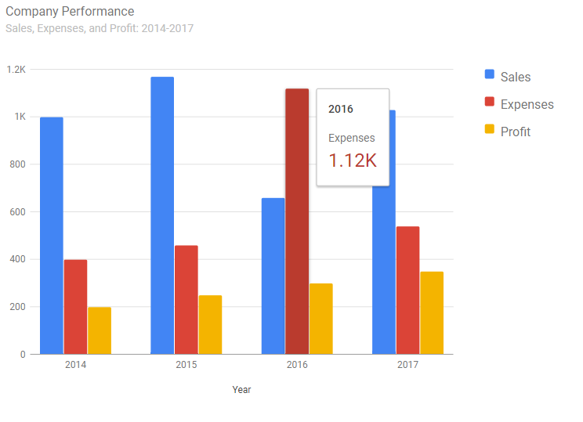
Google Charts
google.charts.load('current', {'packages':['bar']});
google.charts.setOnLoadCallback(drawChart);
function drawChart() {
var data = google.visualization.arrayToDataTable([
['Year', 'Sales', 'Expenses', 'Profit'],
['2014', 1000, 400, 200],
['2015', 1170, 460, 250],
['2016', 660, 1120, 300],
['2017', 1030, 540, 350]
]);
var options = {
'width':700,
'height':500,
title: 'Company Performance',
subtitle: 'Sales, Expenses, and Profit: 2014-2017',
};
var chart = new google.charts.Bar(document.getElementById('chart_div'));
chart.draw(data, google
.charts.Bar.convertOptions(options));
}

Slide 62
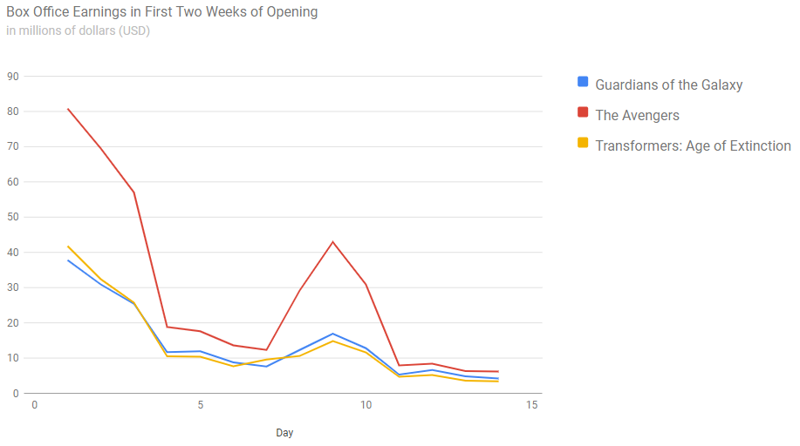
Google Charts
google.charts.load('current', {'packages':['line']});
google.charts.setOnLoadCallback(drawChart);
function drawChart() {
var data = new google.visualization.DataTable();
data.addColumn('number', 'Day');
data.addColumn('number', 'Guardians of the Galaxy');
data.addColumn('number', 'The Avengers');
data.addColumn('number', 'Transformer: AOE');
data.addRows([
[1, 37.8, 80.8, 41.8],
…
[14, 4.2, 6.2, 3.4]
]);
var options = {
title: 'Box Office in First Two Weeks',
subtitle: 'in millions of dollars (USD)’,
width: 900,
height: 500
};
var chart = new google.charts.Line(document.getElementById('chart_div'));
chart.draw(data, google.charts.Line.convertOptions(options));
}

Slide 63
Google Charts
You can always hover over the data to see more specific info
Code samples for all of them that you can copy and modify

Slide 64
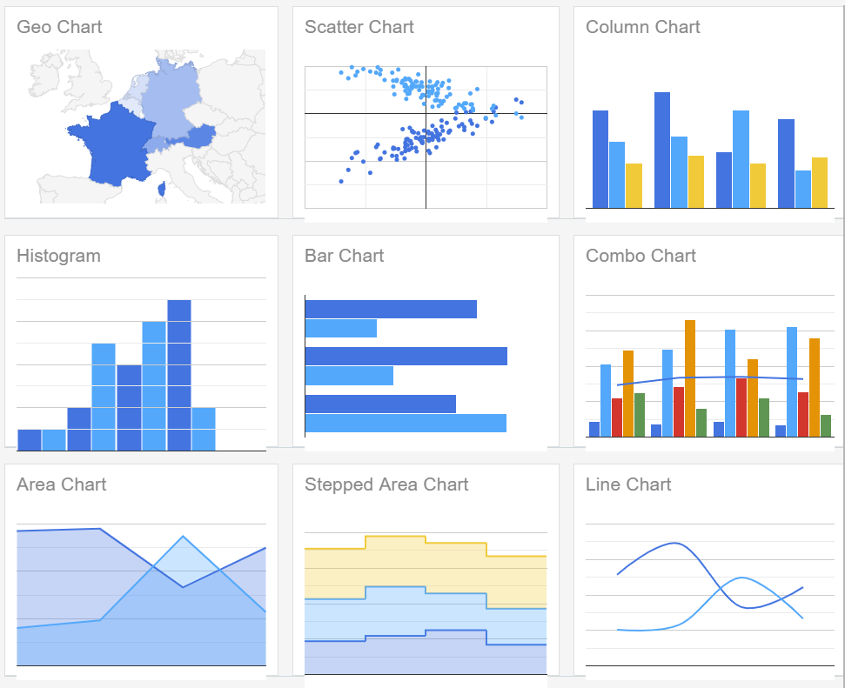
Google Chart Options

Slide 65
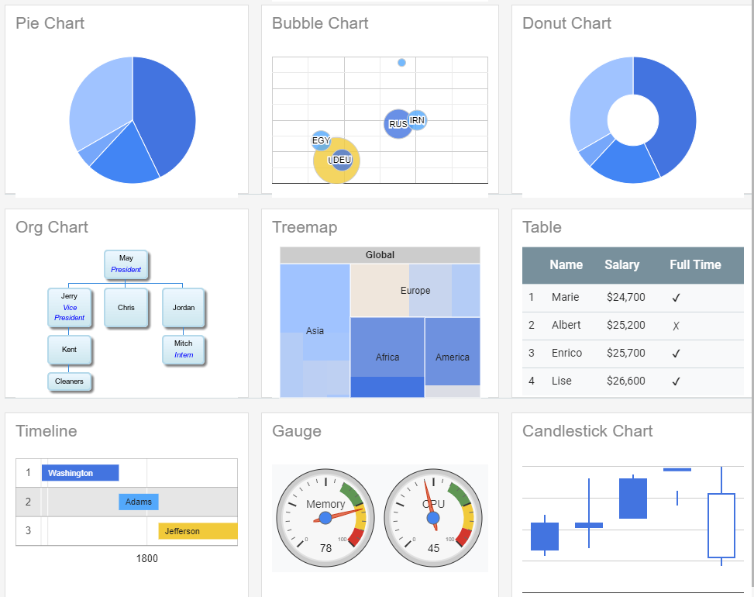
Google Chart Options

Slide 66
Google Chart Options
https://developers.google.com/chart/interactive/docs/gallery

Slide 67
Next time
We will continue with:
Javascript, Search Engine Optimization, Analysis and Advertising

